Slide 1
Laura Kalambokidis
One Minnesota Conference January 7, 2015 Minneapolis, MN
Minnesota’s Economic Outlook
MINNESOTA MANAGEMENT & BUDGET
MMB.STATE.MN.US

Slide 2
Jobs were added across nearly all sectors during Minnesota’s recovery
Surpassed Pre-Recession
Employment Peak in Sept 2013
(8-months ahead of U.S. in May 2014)
Source: MN Department of Employment and Economic Development (DEED)

Slide 3
Minnesota’s economic expansion continues
Source: Minnesota Department of Employment and Economic Development (DEED)

Slide 4
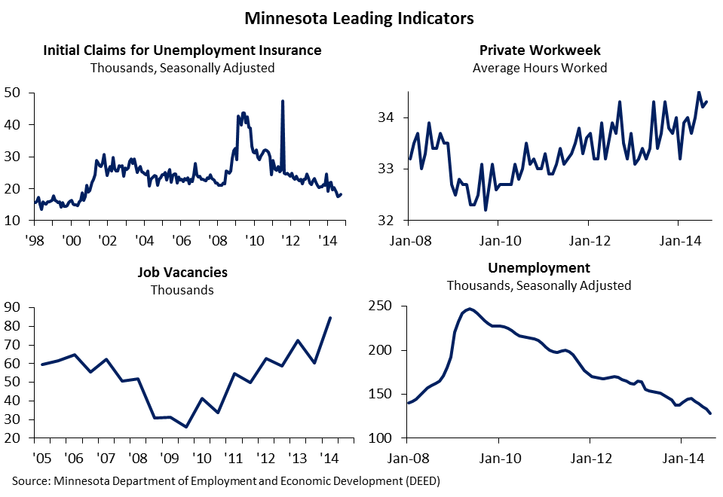
Minnesota’s leading labor market indicators remain strong

Slide 5
Wage growth has not met expectations
Source: U.S. Bureau of Economic Analysis; IHS Economics; Minnesota Management and Budget (MMB)

Slide 6
November 2014 revenue forecast
Tax revenues ended FY 2014 ahead of forecast, increasing the current biennium revenue forecast.
Individual income and general sales taxes drive projected tax revenue growth in the next biennium.
Forecast expects:
Employment to grow modestly
Wage growth to pick up
Housing recovery to regain momentum
U.S. economy to meet expectations

Slide 7
Leadership choices will affect future economic performance
Productivity matters
Health
Education
Research, innovation
Infrastructure
Leave no worker behind
Leave no entrepreneur behind
Reducing uncertainty is pro-business

